Slide 1


Slide 2
SQL World Bank Financial bank loans and insights
The data is a quarterly set from the World Bank
We will be reviewing and providing insight based on findings
Interpret and analyze using statistical techniques and SQL
To be reviewed:
Return all of the table
Return all rows of the table, but only the borrower & due to IDA column
Only show the first 5 rows of the previous query
Abbreviate one of the column names so it's easier to write
Show us all transactions from the Nicaragua (the country)?
How many total transactions?
How many total transactions per country??
What is the max owed to the IDA?
Which was the most recent to pay?
Who has the most loans?

Slide 3

Reviewing the data
SQL is used to analyze larger data sets.
The Bank data has over a million records, 1109994 to be exact.
Using SQL to review the data we can use “LIMIT” to pull up and review the data records. Typically depending on computer resources a ”LIMIT” will need to be used to be able to review a snapshot of the table (or the computer may lock up and freeze).
We can also abbreviate data names, so they are easier to write and remember. This is done utilizing the “AS” command.

Slide 4

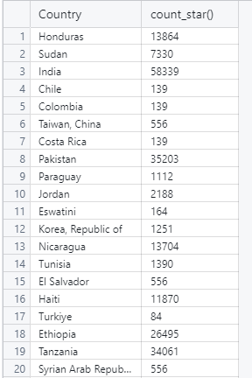
Running SELECT Borrower, "Due to IDA" FROM 'banking_data’; shows us that there is over a million records of Borrower and Individual Development Accounts(IDA). Upon further review almost half, 510870, have an IDA of less than 1 and 440172 have an account balance of zero. Drilling down a little more, using the “WHERE” . We can filter and select what we want to review. Selecting a random country, Nicaragua will be the location that we will analyze, running the following will show us all transactions : select count("Due to IDA") from banking_data WHERE "Country" = 'Nicaragua’; Total transaction number is : select Country, COUNT(*) FROM banking_data Group BY "Country"; tells the story of how many transactions per country. Please see snapshot of 20 (actual total of 137):

Slide 5




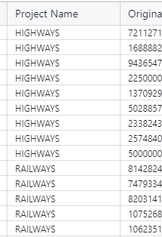
The Max amount owed to the IDA is The MIN amount owed to the IDA is negative: The total SUM owed to the IDA is : The AVG (average) owed to the IDA is: We can also rename data columns with “AS” , column AS new name For World Bank data we can review what transactions have the highest & lowest service charge rates: SELECT * FROM Banking_Data WHERE "Service Charge Rate" > 0 ORDER BY "Service Charge Rate" LIMIT 15; We can also review multiple columns of data with “AND” , here we see loans in Nicaragua and service charge larger than 1 : brings back 840 transactions ; above 4 but no greater than 5 is 75 transactions. We can also review by “projects” SELECT * FROM "banking_data" WHERE "Project Name" = 'HIGHWAYS' OR "Project Name" = 'RAILWAYS' LIMIT 5000;

